Slide 1
SONET
Manik Sejwal
02111502716

Slide 2
SONET stands for Synchronous Optical Networking
SONET is a product of the American National Standards Institute (ANSI)

Slide 3
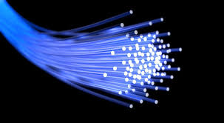

Slide 4
Synchronous optical networking (SONET) is a standardized digital communication protocol
It is used to transmit a large volume of data over relatively long distances using a fiber optic medium
With SONET, multiple digital data streams are transferred at the same time over optical fiber using LEDs and laser beams

Slide 5
SONET and Synchronous Digital Hierarchy (SDH) use lasers or highly coherent light from LEDs
It was developed to replace the plesiochronous digital hierarchy (PDH) system.
PDH was used for transporting large amounts of telephone calls and data traffic over the same fiber without the problems of synchronization.

Slide 6
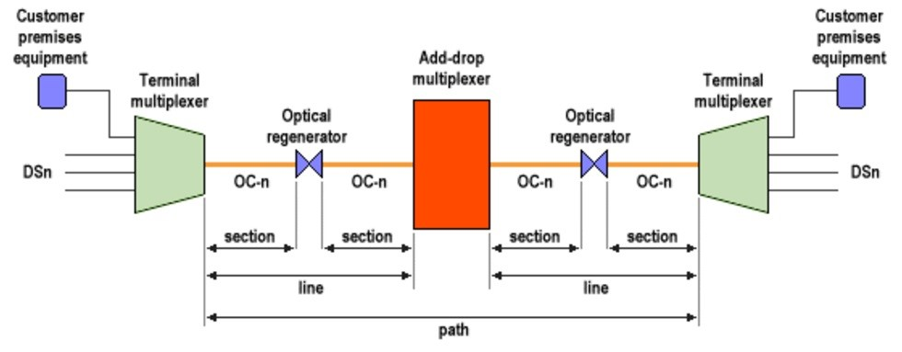

Slide 7
SONET may use a re-generator for long haul distances
Signals are transmitted into electrical signals and then re-generated into high-power signals
At low transmission rates data can also be transferred via an electrical interface

Slide 8
The overhead is interwoven with the payload during the process of transmission.
The transmission alternates between overhead and payload until the completion of the transmission process
The basic format of a SONET/SDH signal allows it to carry many different services in its virtual container (VC), because it is bandwidth-flexible

Slide 9
SONET refers to this basic unit as an STS-3c (Synchronous Transport Signal 3, concatenated)
The STM-1/STS-3c frame is 2,430 octets in size.
It oper\tes three times faster than an STS-1
Nine octets of overhead are transmitted, followed by 261 octets of payload
This is also repeated nine times until 2,430 octets have been transmitted, also taking 125 µs

Slide 10
References
https://en.wikipedia.org/wiki/Synchronous_optical_networking
https://www.techopedia.com/definition/25280/synchronous-optical-networking-sonet

